Slide 1


FastFood: Food Delivery Application
A seamless and efficient food ordering experience, designed for modern diners and local restaurants.
Submitted By: Pavan Bajirao Yevle (Team Leader) & Shivraj Kharat
Course: Diploma in Computer Engineering – Final Year
Project Guide: Ravi Kandekar(React Native Developer)

Slide 2
Introduction
The Food Delivery App is designed to provide users with a seamless and convenient way to order food from their favorite restaurants anytime, anywhere. In today’s fast-paced lifestyle, people often prefer quick and hassle-free solutions for their meals. This app bridges the gap between customers and restaurants by offering an easy-to-use digital platform that ensures timely food delivery at their doorstep.
With a user-friendly interface, secure payment options, real-time order tracking, and a wide variety of restaurants and cuisines, the app enhances the overall food ordering experience. It not only benefits customers by saving time and effort but also helps restaurants expand their reach and grow their business digitally.

Slide 3
Project Overview & Objectives
This project introduces FastFood, a user-friendly Android application designed to streamline the food ordering and delivery process for a single restaurant. It focuses on providing a seamless experience from menu browsing to real-time order tracking.
Key Benefits
Fast ordering, easy real-time tracking, and secure payment options.
Real-time Tracking
Enable real-time delivery tracking using interactive maps to enhance order transparency.
Cash On Delivery Support
Support cash-on-delivery (COD) payment method to make the system accessible to all users.
Platform Support
Designed for Android devices; future updates will add iOS support for Apple users.

Slide 4
Key Features of FastFood
FastFood is built with a comprehensive set of features to ensure a smooth and efficient user experience, from initial login to order completion.
User Authentication
Username/Password login
Profile management
Real-time Features
Live delivery tracking
Push notifications
Food Discovery
Category-based browsing
Search functionality
Popular items & special offers
Order Management
Cart & order history
Order tracking
Payment integration(COD)

Slide 5






Tools & Technologies Used
The FastFood application leverages a robust stack of modern technologies to deliver its seamless user experience and real-time functionalities.
Frontend Technologies
Backend Services
Development Tools
React Native
Firebase Realtime Database
Visual Studio Code
React Navigation
Firebase Cloud Messaging
Android Studio
React Native Maps
Git & GitHub
Postman

Slide 6
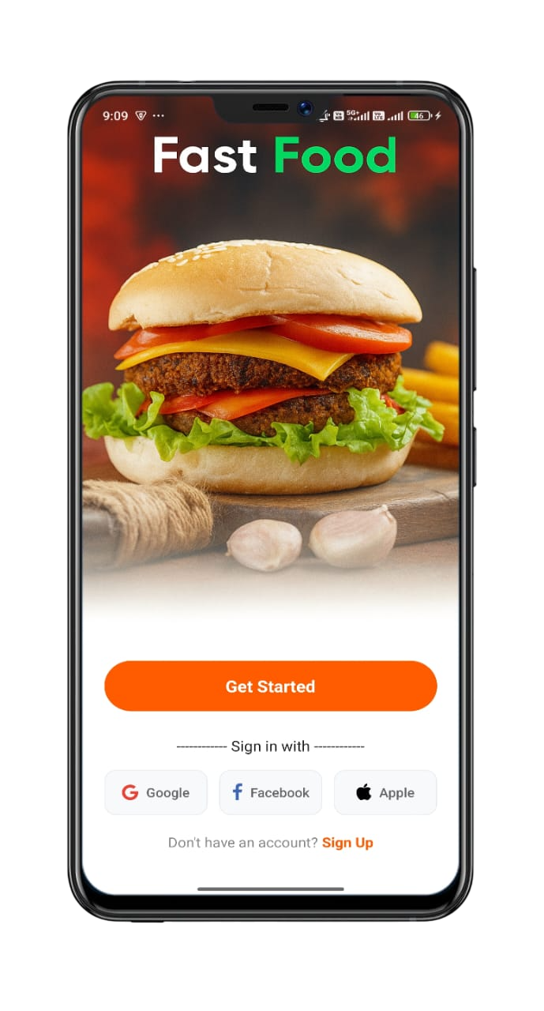
Welcome Screens
The app opens with a visually engaging welcome screen that features vibrant branding, enticing food imagery, and a clear call-to-action, instantly capturing user attention and setting a friendly tone for the experience.
Welcome Screen
Prominent "Fast Food" branding with stylish fonts.
Social media login options (Google, Facebook, Apple ID).
High-quality burger image symbolizing core service.
Central "Get Started" button for user guidance.

Slide 7
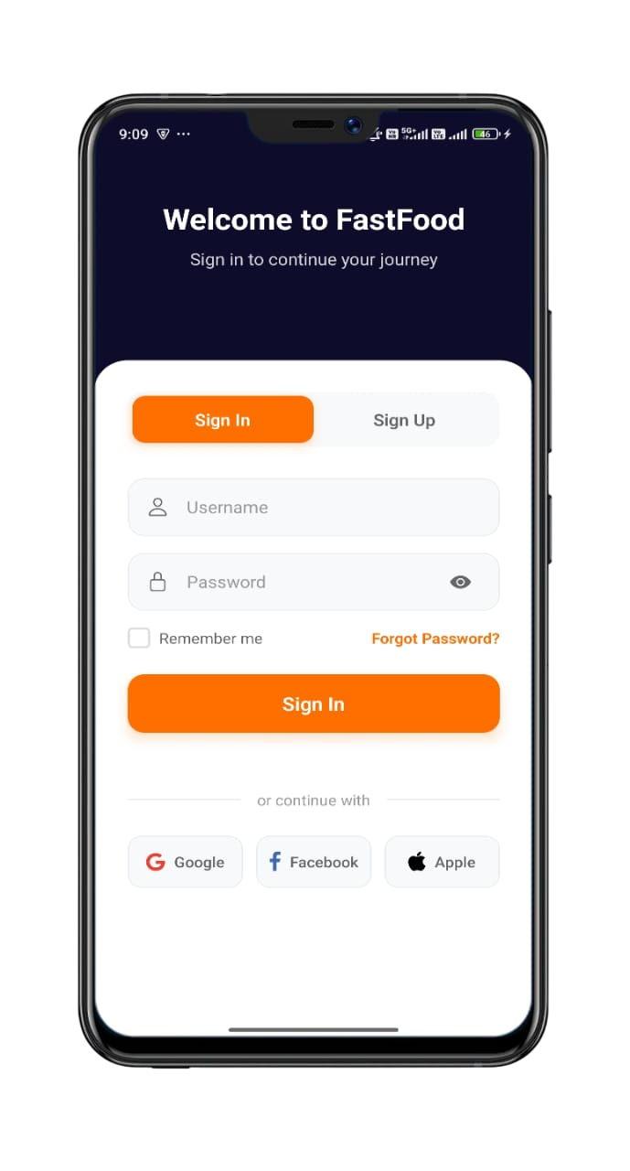

Authentication Screens
The sign-in and sign-up screens are designed with simplicity and security in mind, offering quick access through email, password, or social accounts, along with an intuitive layout that ensures a smooth onboarding process for all users.
Welcomming messages and clean navigation tabs
Secure input fields with password visibility toggles
Prominent “Sign In” and “Create Account” Buttons

Slide 8
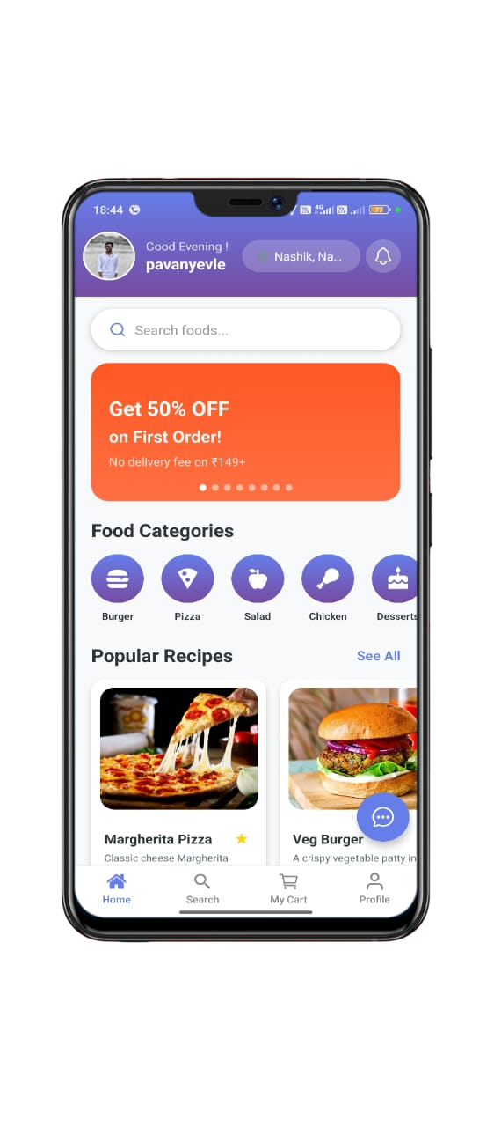
Home
The home screen acts as the central hub for exploring food options, featuring personalized greetings, an efficient search bar, promotional banners, and easily navigable food categories to enhance the browsing experience.
Home Screen
Personalized greeting with user name and location.
Prominent search bar for food items.
Rotating promotional banners for special offers.
Horizontally scrollable food categories.
Popular recipes section with trending items.

Slide 9
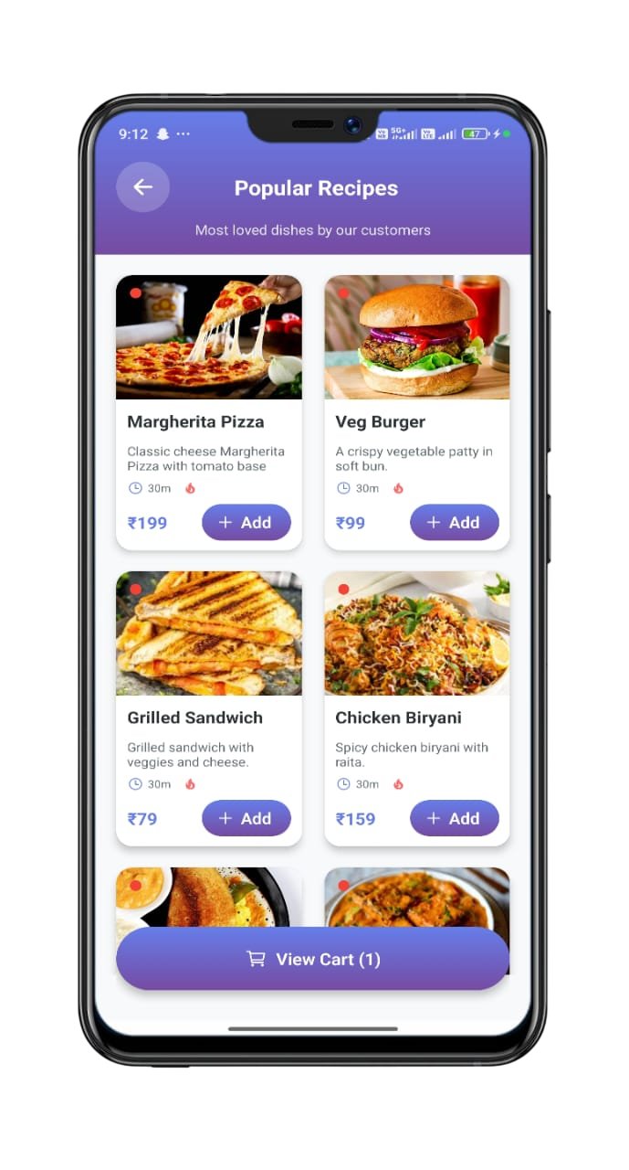
Polular Recipes
The popular recipes screen showcases the most loved dishes in a grid layout, featuring images, descriptions, prices, and quick add-to-cart options for easy ordering.
Polular Recipes Screen
Food Grid Layout – Two-column grid displaying popular food items.
Food Item Card –
Image – High-quality food photo at the top.
Name & Description – Dish name in bold with a short description.
Icons – Preparation time (clock icon) and popularity (flame icon).
Price & Add Button – Price in ₹ and a purple “+ Add” button for adding items to the cart.
Cart Summary Bar – Purple gradient bar at the bottom showing "View Cart" with the
number of selected items.

Slide 10
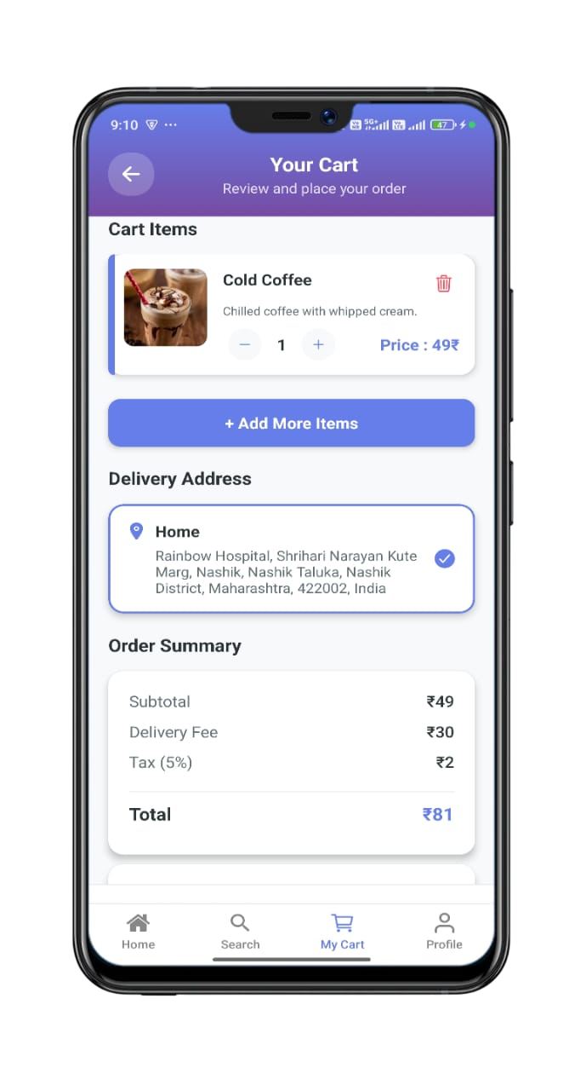
Cart & Order Management
The My Cart screen provides a seamless checkout experience, allowing users to review items, select delivery details, and confirm their order.
My Cart Screen
Displays food items with images, titles, and descriptions.
Quantity control buttons and delete options for items.
Option to add more items before checkout.
Delivery address selection with location icon.
Detailed order summary with subtotal, delivery fee, and tax.
Estimated delivery time and location confirmation.
Place Order Button

Slide 11
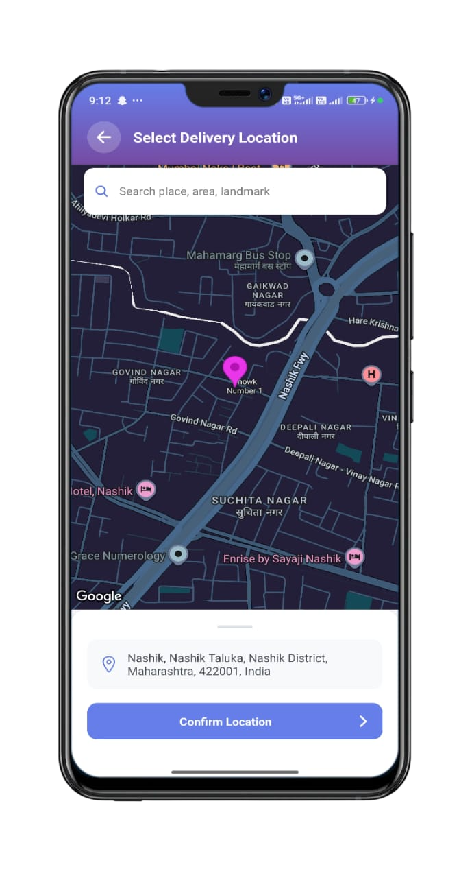
Select Address
The Select Address screen lets users quickly choose or add a delivery location, ensuring accurate and hassle-free order fulfillment.
Select Address Screen
Displays the chosen delivery address clearly for confirmation.
Allows quick edits or selection of a different saved address.
Ensures accurate delivery location before placing the order.
Press Confirm Location Button

Slide 12
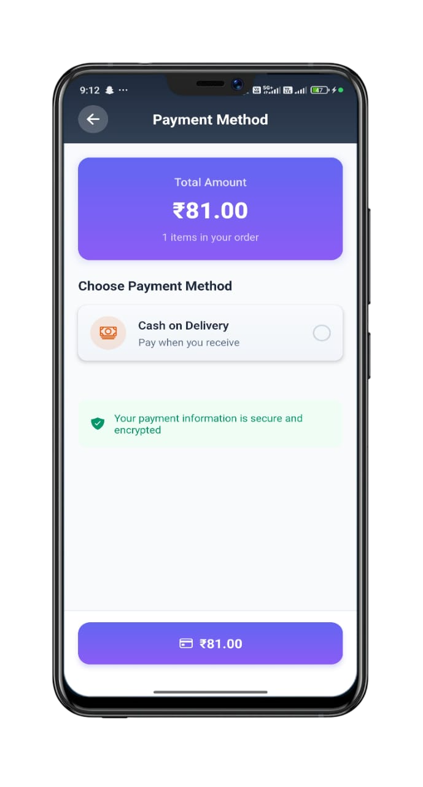
Payment Method
The payment method screen displays the total payable amount and allows users to choose their preferred payment option, such as Cash on Delivery, while assuring secure and encrypted transaction information.
Payment Screen
Total Amount Card – Shows the total bill (₹81.00) along with the number of items in the order.
. Payment Options – Cash on Delivery option with icon and description (“Pay when you receive”).
Security Info – Green highlighted message assuring that payment details are secure and encrypted.
Confirm Payment Button – Purple button at the bottom displaying the payable amount to proceed
with the order.

Slide 13
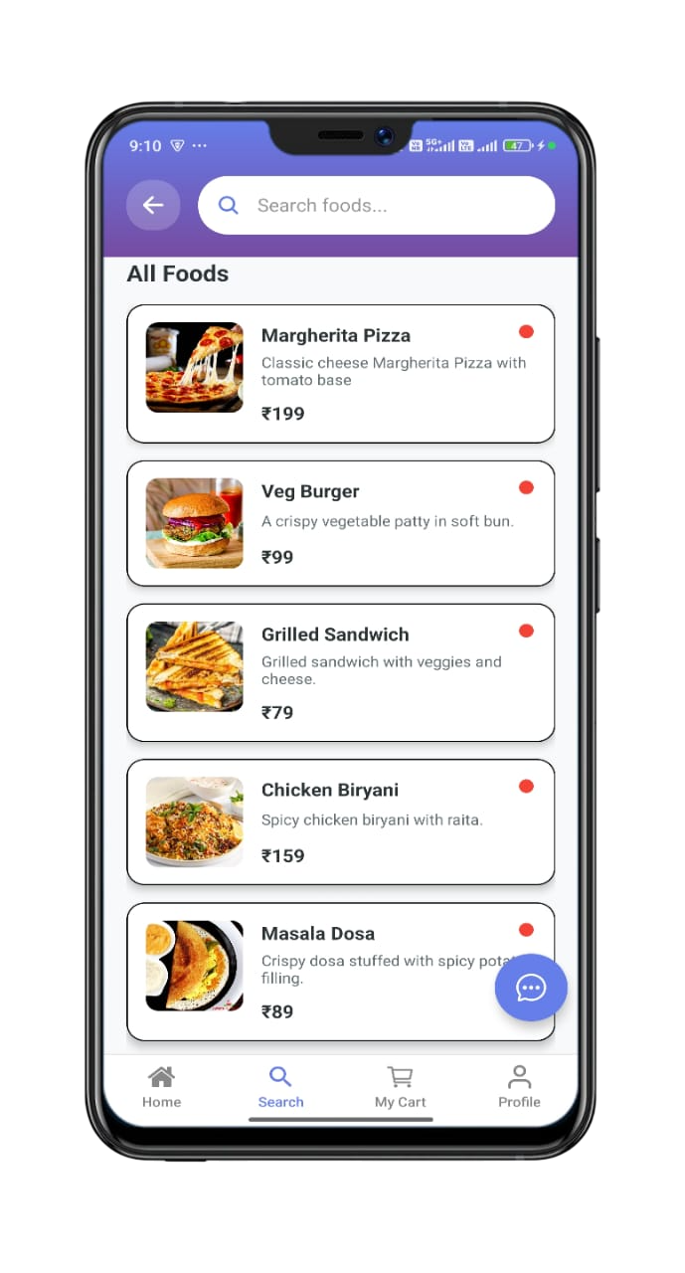
Search Screen
The search screen allows users to quickly find their favorite dishes through a dedicated search bar, displaying a list of food items with images, descriptions, prices, and indicators for easy selection.
Search Screen
Header – Back button, search bar with "Search foods..." placeholder, purple gradient
background.
Food Cards – Image (left), name & short description, price in ₹, red dot indicator,
rounded card design
Bottom Navigation – Home, Search (active), My Cart, Profile.
Floating Action Button – Blue chat/help icon at bottom-right.

Slide 14
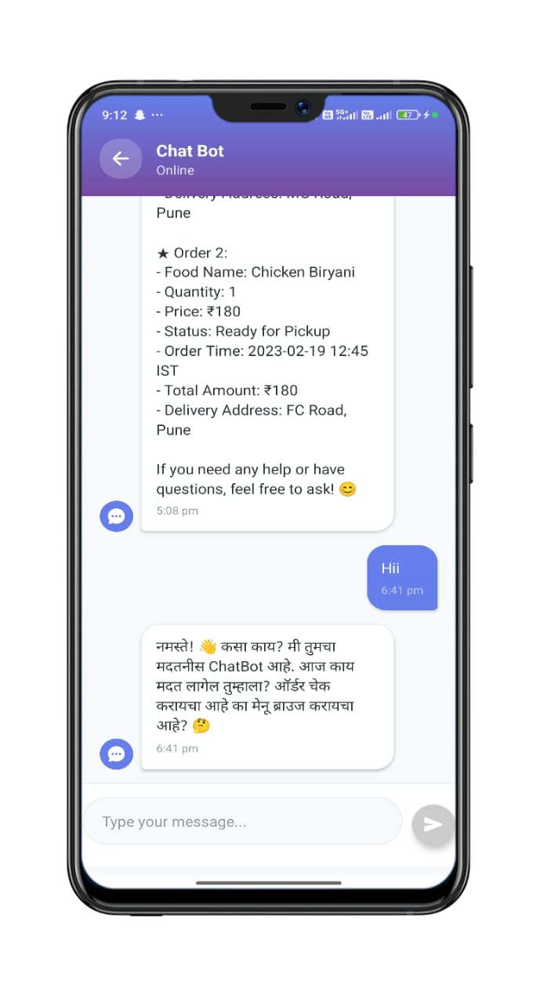
Chat Bot
The chat bot screen enables real-time assistance, allowing users to check order details, ask questions, and receive automated responses for faster support.
Chat Bot Screen
Order Details – Bot message showing order summary including food name, quantity, price, status,
time, total amount, and delivery address.
User Messages – User’s input displayed in a chat bubble format.
Bot Responses – Automated replies in both English and Marathi, offering help and suggesting possible
actions.
Message Input Field – Text box with send button for typing and sending queries.

Slide 15
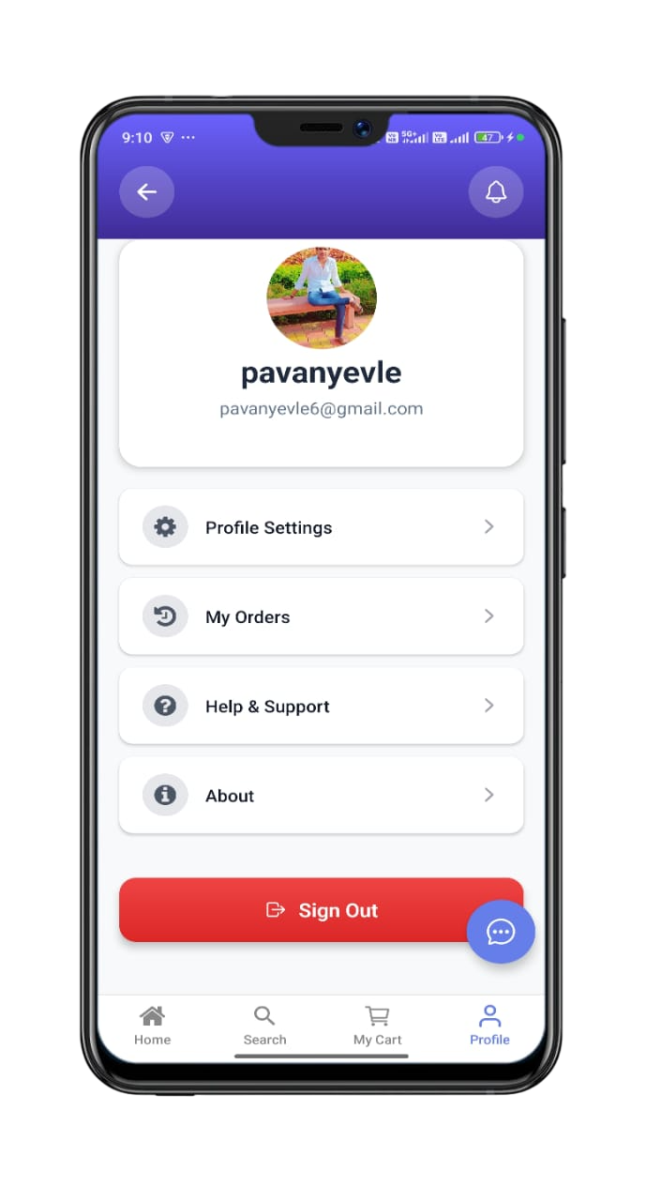
Profile
The profile screen provides comprehensive account management, allowing users to view order history, update personal details, access customer support, and manage settings with a clean, user-friendly layout.
Profile Screen
Displays user profile picture, name, and email.
Actionable items for profile settings, orders, and support.
Secure sign-out option.

Slide 16
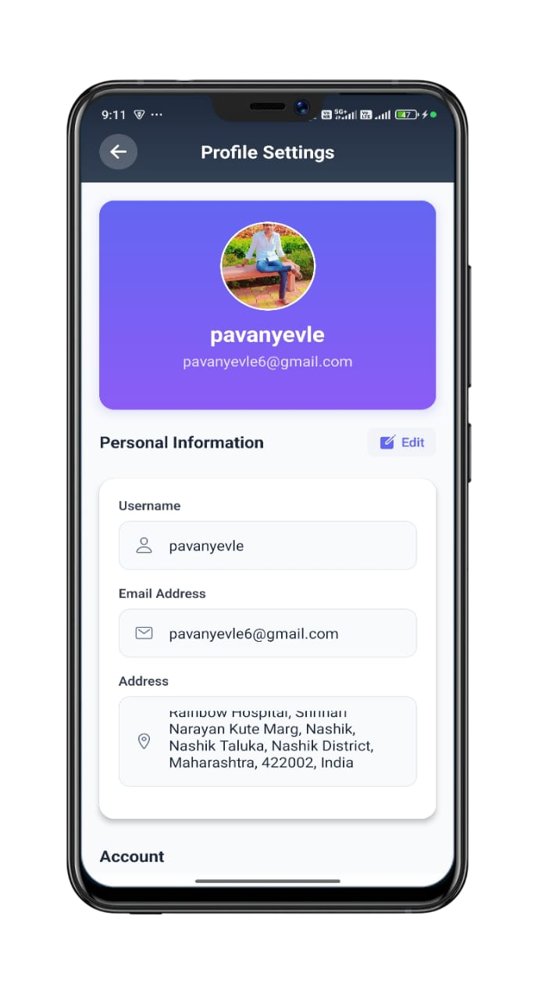
Profile Setting
The profile settings screen allows users to view and update their personal information, including profile picture, username, email address, and delivery address, Change password, Logout, Delete Account
Profile Setting Screen
Profile Card – Purple background with circular profile picture, username, and email address.
Edit Option – Edit button to update personal information.
Change Password – Option to update the account password.
Logout – Button to securely sign out from the app.
Delete Account – Option to permanently remove the user account and data.

Slide 17
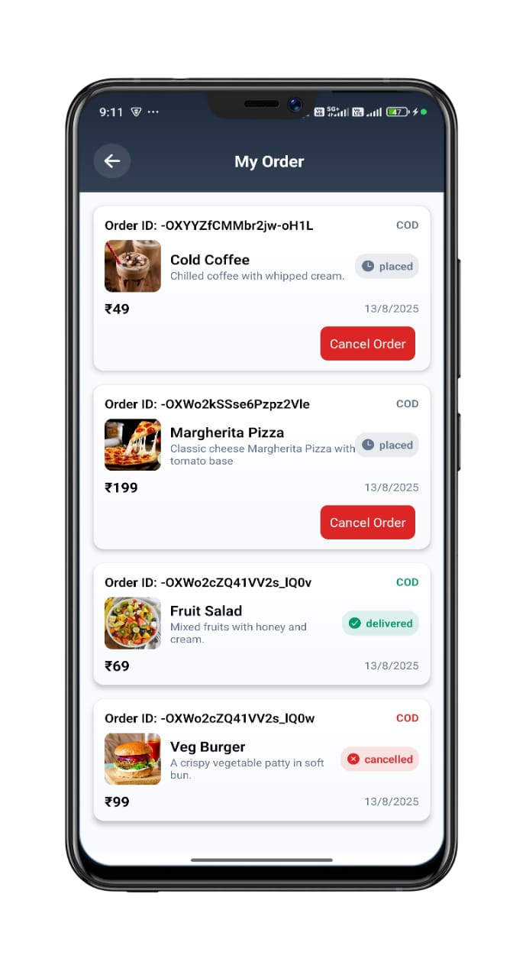
Order History
The My Orders screen provides a comprehensive history of all user orders, while the Help & Support screen ensures users can easily find answers and assistance.
My Orders Screen
Displays order cards with ID, food details, price, and date.
Shows payment type (e.g., COD) and clear order status badges.
Includes a "Cancel Order" button for eligible orders.

Slide 18
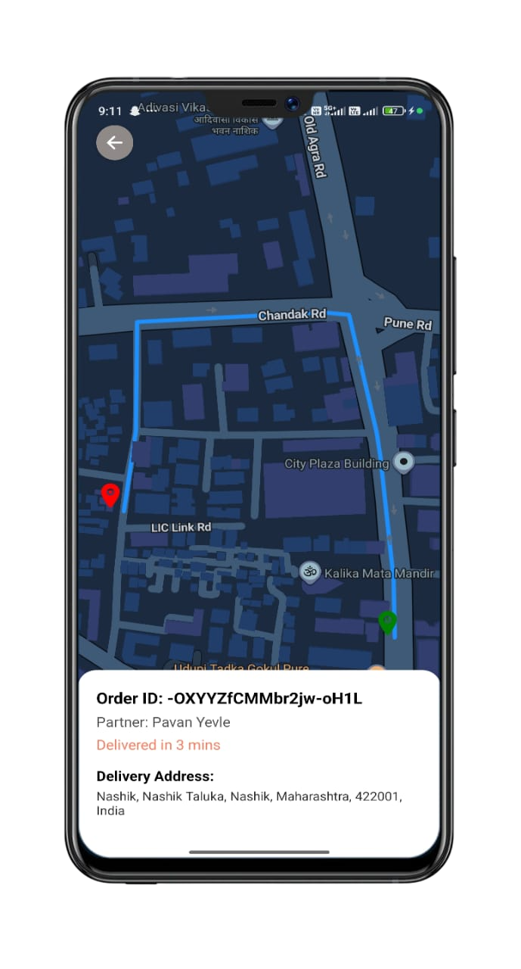
Real-time Delivery Tracking
The Delivery Tracking screen offers full transparency, allowing users to monitor their order's live location and estimated delivery time.
Live Map Tracking
Displays the route from the restaurant to the customer's address.
Shows the current position of the delivery partner.
Clear visual indicators for restaurant (green) and customer (red).
Includes Order ID, Partner Name, and Delivery Time Status.
Full delivery address display for confirmation.

Slide 19
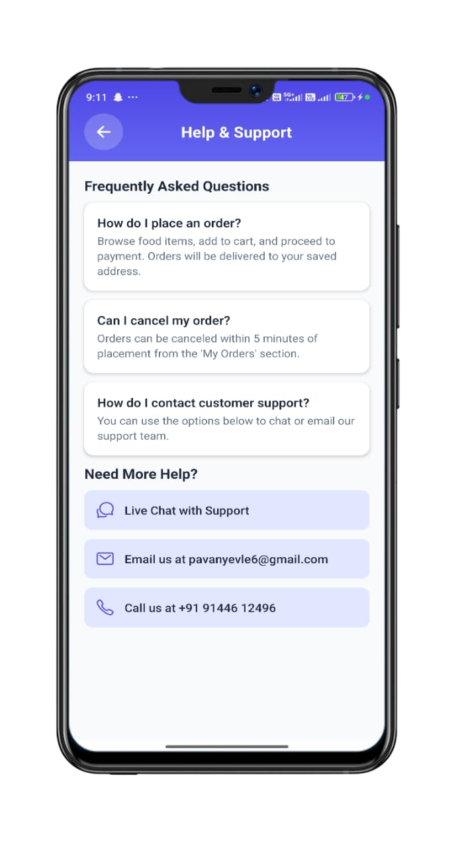
Help & Support
The help & support screen provides quick answers to frequently asked questions and offers multiple contact options, including live chat, email, and phone support, for resolving user queries.
Help & Support Screen
Live Chat with Support – Direct chat option for instant help.
Email Support – Email address for queries.
Phone Support – Contact number for direct assistance.

Slide 20
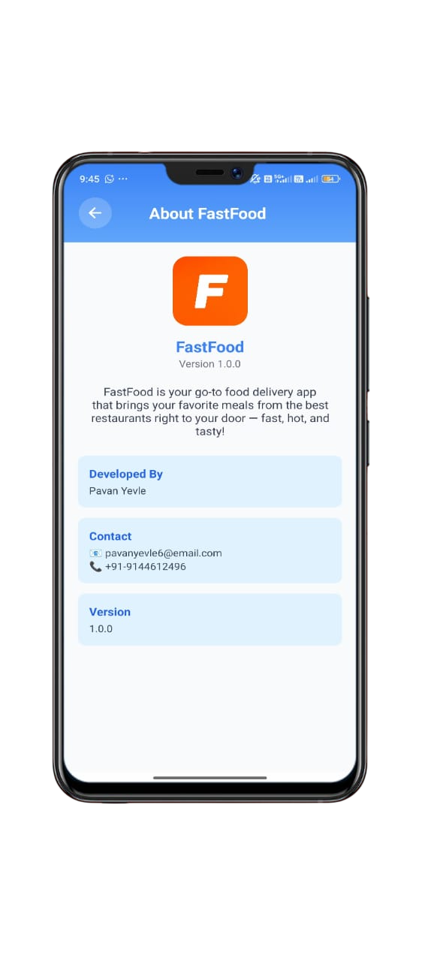
About FastFood
The about screen introduces the FastFood app, showcasing its purpose, version, developer details, and contact information for easy communication.
About Screen
App Logo & Name – FastFood logo with app name and version (1.0.0).
App Description – Brief intro highlighting the app as a quick and tasty food delivery service from
top restaurants.
Developer Info – Name of the developer (Pavan Yevle).
Contact Section – Email address and phone number for support or feedback
Version Info – Current version displayed clearly.

Slide 21
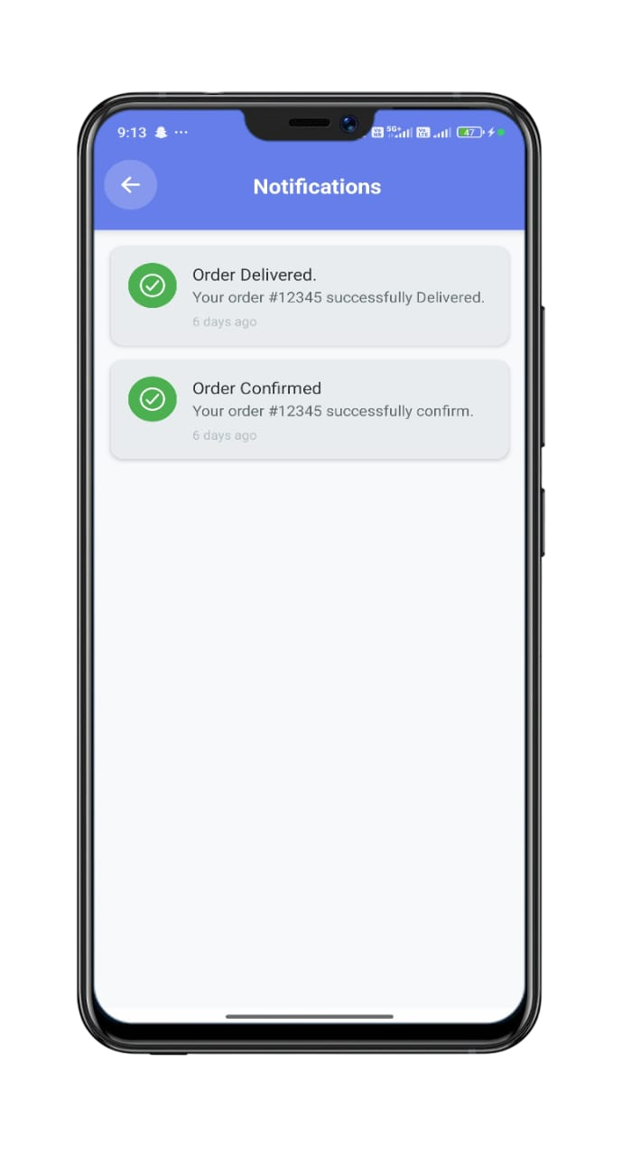
Notifications
The notifications screen displays real-time order updates, helping users stay informed about their delivery status.
Notifications Screen
Order Delivered Notification – Confirms that the order was successfully delivered,
with order ID and time.
Status Icons – Green check marks to indicate successful updates.

Slide 22



Challenges, Solutions & Future
Developing FastFood involved overcoming technical challenges with robust solutions, paving the way for exciting future enhancements.
Technical Challenges & Solutions
Future Enhancements
Real-time Order Tracking
1
Multiple Payment Gateways
Solution: Firebase Realtime Database
Push Notifications
Solution: Firebase Cloud Messaging
2
Social Media Integration
Location Services
Solution: React Native Geolocation
3
Restaurant Partner Portal
4
Analytics Dashboard
5
Multi-language Support
Conclusion: FastFood successfully demonstrates a modern food delivery application with real-time features and a smooth user experience, showcasing
practical mobile app development concepts.

Slide 23
Thank You !

